Slide 1

Mastering Incident Response A Guide for IT Professionals

Slide 2
Agenda
Introduction ~ Why Incident Response Matters
Phase 1: Preparation
Phase 2: Identification
Phase 3: Containment
Phase 4: Eradication
Phase 5: Recovery
Phase 6: Lessons Learned
Phase 7: Prevention

Slide 3

Incident Response Matters?

Slide 4
Incident Response What Why & How?
Structured iterative methodology for handling security breaches, cyberattacks, and cybersecurity defensive measures
Goal: Manage incidents to minimize damage, reduce recovery time and costs, and mitigate exploited vulnerabilities
Ensure confidentiality, integrity, and availability (CIA) of data and systems Business Continuity (BCP) & Disaster Recovery (DR)
Develop policies, plans, and preventive measures to remove threats and return systems to an operational state
Integrated into security operations, including continuous monitoring, threat intelligence, and defense strategies
Collaboration across IT, security, legal, HR, and communications

Slide 5

Setting the Stage
Cyberattack Mitigation for Rural K-12 Public School District

Slide 6
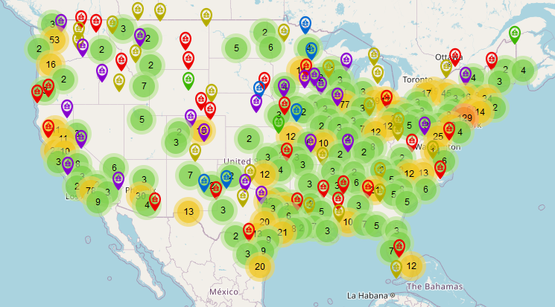
K12 Security Information Exchange and EdTEch Strategies, LLC. (2023, February 13). The K12 Cyber Incident Map. K12 SIX. https://www.k12six.org/map

Slide 7
NOTES ~ FERPA: Family Education Rights & Privacy Act
Data Protection and Access Controls
Ensuring only authorized individuals can access or modify student data
Incident Reporting and Response
Compliance with guidelines
Training and Awareness
Vendor Management & 3rd Party Security
Communication Plan
US Department of Education (ED). (2021, August 25). Family educational rights and privacy act (FERPA). Home. https://www2.ed.gov/policy/gen/guid/fpco/ferpa/index.html

Slide 8
Phase 1: Preparation
Incident Response (IR) Team Formation
Tool and Access Preparation
Patch Deployment, SIEM, EDR, Network Analysis/Monitoring, Firewall, IPS, IDS, SOAR, Vulnerability Scanners, Forensics
Secure Infrastructure
Security Awareness, Culture, and Training
Communication Plan
A-poc. (n.d.). A-POC/blueteam-tools: Tools and techniques for Blue Team / Incident Response. GitHub. https://github.com/A-poc/BlueTeam-Tools

Slide 9
Phase 2: Identification
Incident Identification
Breach Confirmation
Assessment of Scope
System & Network Monitoring
Incident Documentation

Slide 10
Phase 3: Containment
Immediate Actions
Disconnect, Segregate, and Isolate
Quarantine
Intercept and Restrict
Long-Term Containment
Passwords and Credentials
Stricter Rules
Multifactor Authentication

Slide 11
Phase 4: Eradication
Remove Threats
Antivirus, Antimalware, EDR
Reimage, Reinstall, Redeploy
System Updates
Patch Deployment
Updating antivirus/antimalware definitions
& firewall rules

Slide 12
Phase 5: Recovery
Restore Systems & Services
Deploy Backups & Gradual Restoration
Ensure no unauthorized modifications or lost data
Regulatory adherence
Monitoring
Enhanced and Continuous

Slide 13
Phase 6: Lessons Learned
Review, Document, & Analyze
Policy Update
Training Improvements
Communication
Legal & Regulatory Compliance

Slide 14
Phase 7: Prevention
Regular Audits
Red-Team, Vulnerability Assessments,
Penetration Tests
Community Engagement
Law Enforcement & Cybercrime Units
Resilience Planning
NIST Cybersecurity Framework
Cybersecurity Insurance

Slide 15
Incident Response Matters!

Slide 16
The Stage
Purdue University Security Incidents & Compromised PHI
Adler, S. (2018, May 31). Purdue University uncovers data security incidents that potentially ... The HIPAA Journal. https://www.hipaajournal.com/purdue-university-uncovers-data-security-incidents-that-potentially-compromised-phi/

Slide 17


Slide 18


Thank you
Brock ‘INIT 6’ Warner
brock.warner@pm.me
https://linktr.ee/brockwarner

